Slide 1
HCM Extract
MAY -3 -2021.

Slide 2
Agenda
Introduction
Extract Types
HCM Extract Components
HCM Extract Design Flow
Extract Definitions, Extract Block & Extract Link
Extract Record, Extract Data elements & Fast Formulas
Extract Delivery option
Extract BIP Report & Template
Extract validate, submit & Scheduling
Change Only Parameters
Case Study

Slide 3
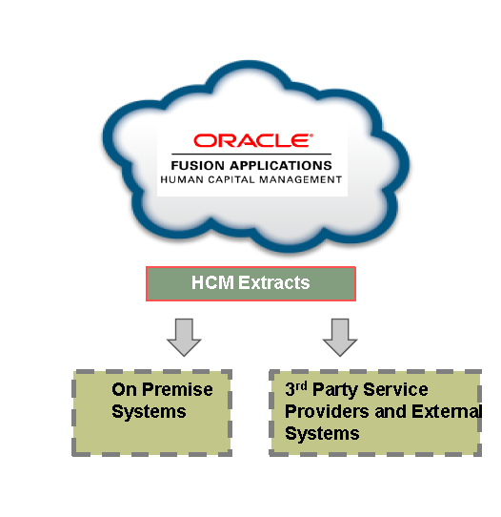
Overview: HCM Extract
HCM Extract is an integration and reporting tool which is used to generate large volume of formatted data out of Fusion HCM system.
Features include:
Ability to extract historical data
Supports Changes only mode and Roll back of changes only
Limited Support for Fast Formulas
Inbound Extracts
Integrated with BI to generate data in variety formats
Output in variety of formats (for example, pdf, csv, xml, Excel)
Supports file encryption
Capable of delivering data onto ftp, email, content server
Choose Data > Gather data > archive > Format > Deliver

Slide 4
HCM Extract Types : Explained
Extract Type | Purpose
Full profile | Used for complete employee and payroll data archives. You can also use this extract type for all custom or seeded extracts
Payroll Interface | Used for providing data to third party payroll service providers . You can also use this extract type for all custom or seeded extracts
Benefits Carrier | Use this type for providing data to third party benefits service providers. You can also use this extract type for custom or seeded extracts
Archive Retrieval | Use this type for reports based on permanently archived data. For example, payslip. This extract type is intended for seeded extracts only
HR Archive | Use this type for all HR archives, and you can also use for custom or seeded extracts.
Other Payroll Archive | Use this type for all Payroll archives, and you can also use for custom or seeded extracts.
Inbound Interface | Inbound Interface is a special type of HCM Extract that is used to insert data into Fusion system.
Notes:
The type of extract you select determines the purpose of the extract. It also determines the parameters that are automatically generated. For example, if you select the Payroll Interface extract type, then the application creates a changes only parameter, as well as the other parameters. You can select the extract type on the Manage HCM Extract Definitions page.

Slide 5
HCM extract Components
Extract was categorized into Four Phases
Define
Design
Delivery
Validate
The different components of HCM Extracts are
Extract Definition
Data Groups
Extract Records
Attributes

Slide 6
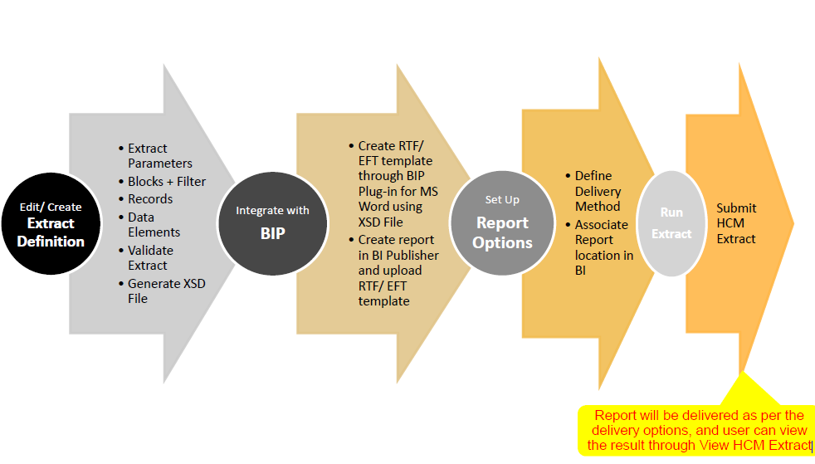
Design Flow Diagram of HCM Extract

Slide 7
HCM Extract- Setup

Slide 8

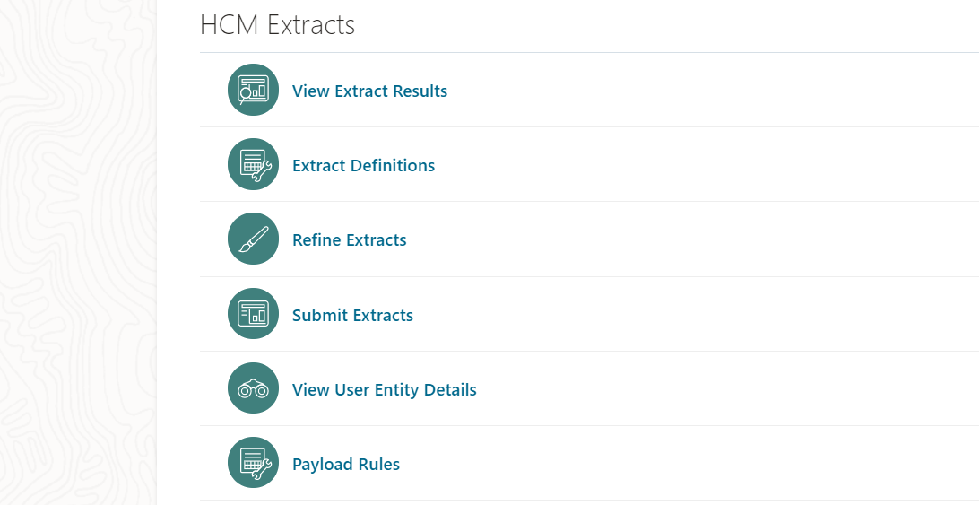
Getting Started with HCM extract
Navigator → My Client Groups → Data Exchange

Slide 9
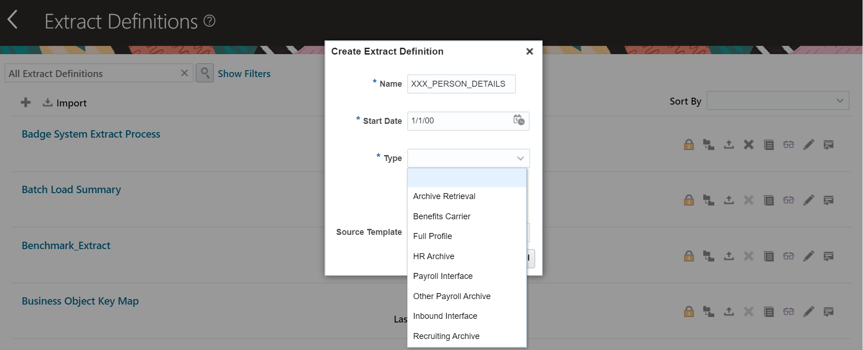
Create New HCM extract

Slide 10
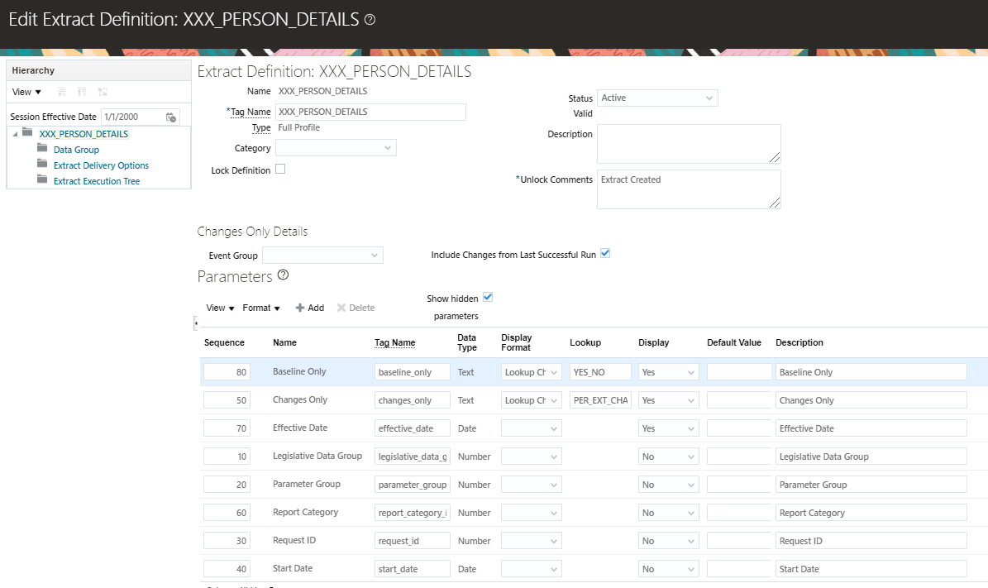
Manage HCM extract Definitions - Parameters
HCM Extracts can have Parameters. Some parameters are pre-selected based on the Extract Type you selected.

Slide 11
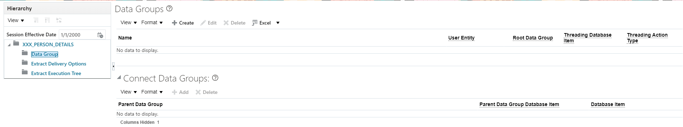
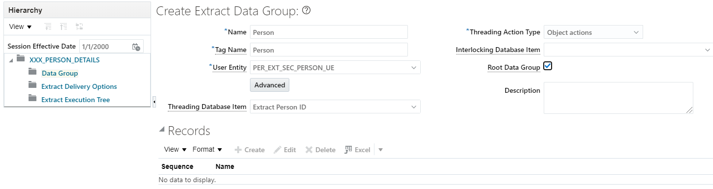
Create Extract Data group/Blocks
Data group represents logical group or business area such as Person , Assignment ,Employee .
We define one data group as root data group and this data group is starting point of data extract .
Data group is associated with User Entity which provides link to database item to retrieve .

Slide 12
User Entities
User Entities (UE’s) are logical units associated with the block, which contains SQL query for fetching
data as needed and placed into Data Groups for example such as Persons, Assignment,
Organizations etc.
User Entity Name and Code | Description
Person (PER_EXT_SEC_PERSON_UE) | Retrieves all persons across the enterprise and all person related attributes.
Worker Payroll (PER_EXT_PAY_EMPLOYEES_UE) | Retrieves all workers and their payrolls across the enterprise, all person, worker, payroll related attributes, and element entry data.
Extract Assignment Basic History (PER_EXT_ASSIGNMENT_BASIC_HISTORY_UE) | Retrieves assignment history as on the assignment effective start date.
Extract Assignment Basic Information (PER_EXT_SEC_ASSIGNMENT_BASIC_UE) | Retrieves assignment data as on the effective date.
Assignments Range (PER_EXT_SEC_ASSIGNMENT_RANGE_UE) | Retrieves assignment history as on the effective date.
Extract Current and Future Persons (PER_EXT_SEC_PERSON_NOW_FUTURE_UE) | Retrieves current and future person details. Specify advanced filter criteria to restrict person types.
Extract Current and Future Assignments (PER_EXT_SEC_ASSIGNMENT_NOW_FUTURE_UE) | Retrieves current and future assignments.

Slide 13
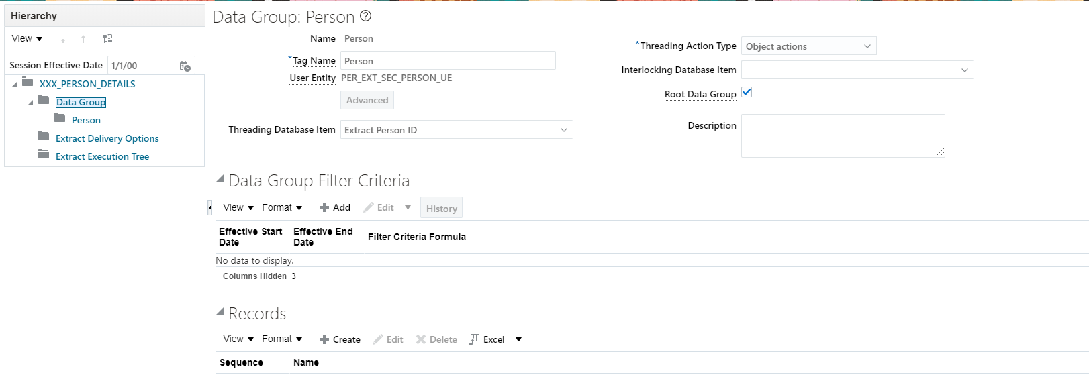
Create Extract Records
Extract Records represent a grouping of related data or a physical collection of all fields required in the extract.
Notes:
Search for a user entity in the View User Entity Details UI and click the User Entity Details tab.
In the View User Entity Details UI, search for a user entity and click the Context tab. The Contexts Required section lists the contexts that you have to set to use the user entity in the extract. For example, the PER_PER_PHONES_UE user entity requires the PERSON_ID context; therefore, you must set the PERSON_ID context to use this user entity. Generally, the user entities that are not historic require the EFFECTIVE_DATE context. However, the EFFECTIVE_DATE context is set by default, so you do not have to set this context explicitly.
Search for UE with table name with the SQL below:
select * from FF_ROUTES where route_id =(select route_id from ff_user_entities_vl where base_user_entity_name = 'HWM_PER_ASG_USER_PERSON_TYPE')

Slide 14
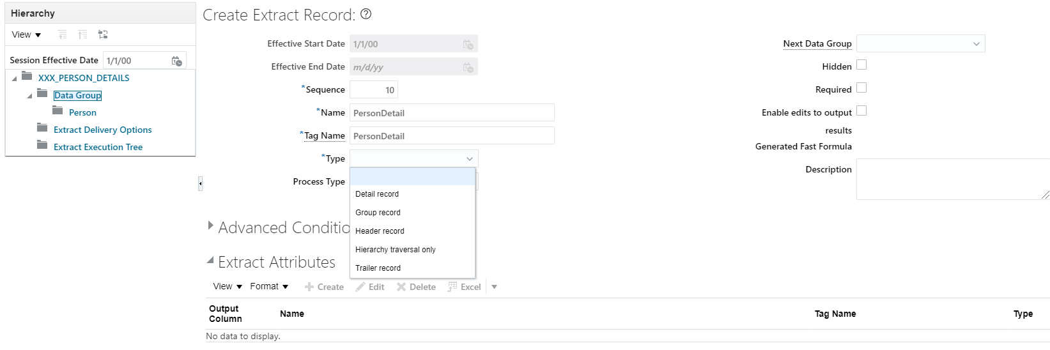
Create Extract Records
Notes:
Search for a user entity in the View User Entity Details UI and click the User Entity Details tab.
In the View User Entity Details UI, search for a user entity and click the Context tab. The Contexts Required section lists the contexts that you have to set to use the user entity in the extract. For example, the PER_PER_PHONES_UE user entity requires the PERSON_ID context; therefore, you must set the PERSON_ID context to use this user entity. Generally, the user entities that are not historic require the EFFECTIVE_DATE context. However, the EFFECTIVE_DATE context is set by default, so you do not have to set this context explicitly.
Search for UE with table name with the SQL below:
select * from FF_ROUTES where route_id =(select route_id from ff_user_entities_vl where base_user_entity_name = 'HWM_PER_ASG_USER_PERSON_TYPE')

Slide 15
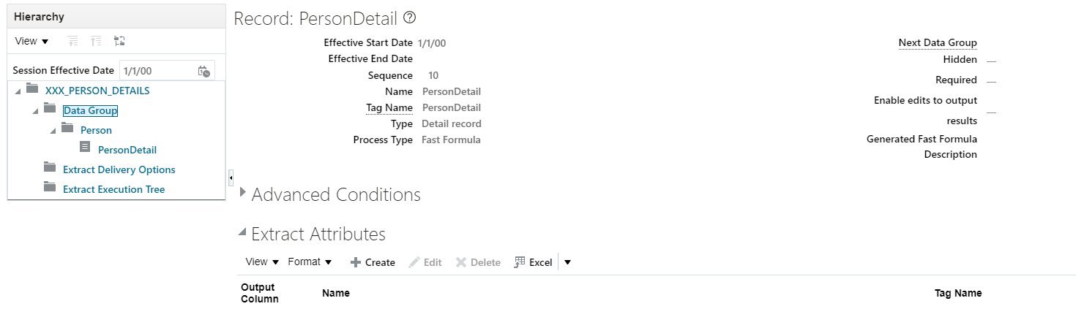
Create Extract Attributes / Data Elements
An attribute is the lowest level of a HCM extract which represents a piece of information. It is an individual field inside extract record .
Notes:
Search for a user entity in the View User Entity Details UI and click the User Entity Details tab.
In the View User Entity Details UI, search for a user entity and click the Context tab. The Contexts Required section lists the contexts that you have to set to use the user entity in the extract. For example, the PER_PER_PHONES_UE user entity requires the PERSON_ID context; therefore, you must set the PERSON_ID context to use this user entity. Generally, the user entities that are not historic require the EFFECTIVE_DATE context. However, the EFFECTIVE_DATE context is set by default, so you do not have to set this context explicitly.
Search for UE with table name with the SQL below:
select * from FF_ROUTES where route_id =(select route_id from ff_user_entities_vl where base_user_entity_name = 'HWM_PER_ASG_USER_PERSON_TYPE')

Slide 16
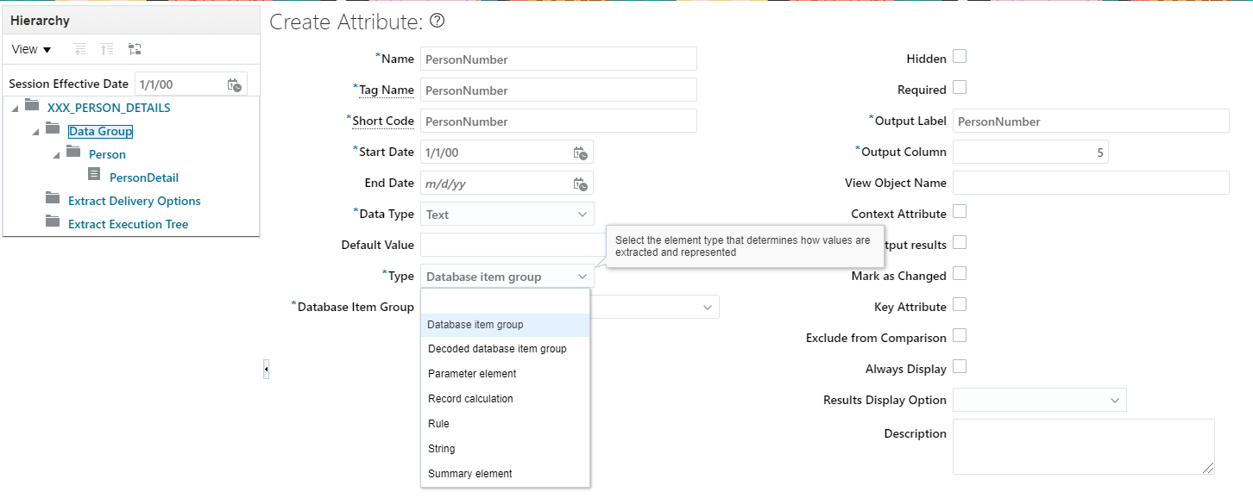
Create Extract Attributes / Data Elements
Notes:
Search for a user entity in the View User Entity Details UI and click the User Entity Details tab.
In the View User Entity Details UI, search for a user entity and click the Context tab. The Contexts Required section lists the contexts that you have to set to use the user entity in the extract. For example, the PER_PER_PHONES_UE user entity requires the PERSON_ID context; therefore, you must set the PERSON_ID context to use this user entity. Generally, the user entities that are not historic require the EFFECTIVE_DATE context. However, the EFFECTIVE_DATE context is set by default, so you do not have to set this context explicitly.
Search for UE with table name with the SQL below:
select * from FF_ROUTES where route_id =(select route_id from ff_user_entities_vl where base_user_entity_name = 'HWM_PER_ASG_USER_PERSON_TYPE')

Slide 17
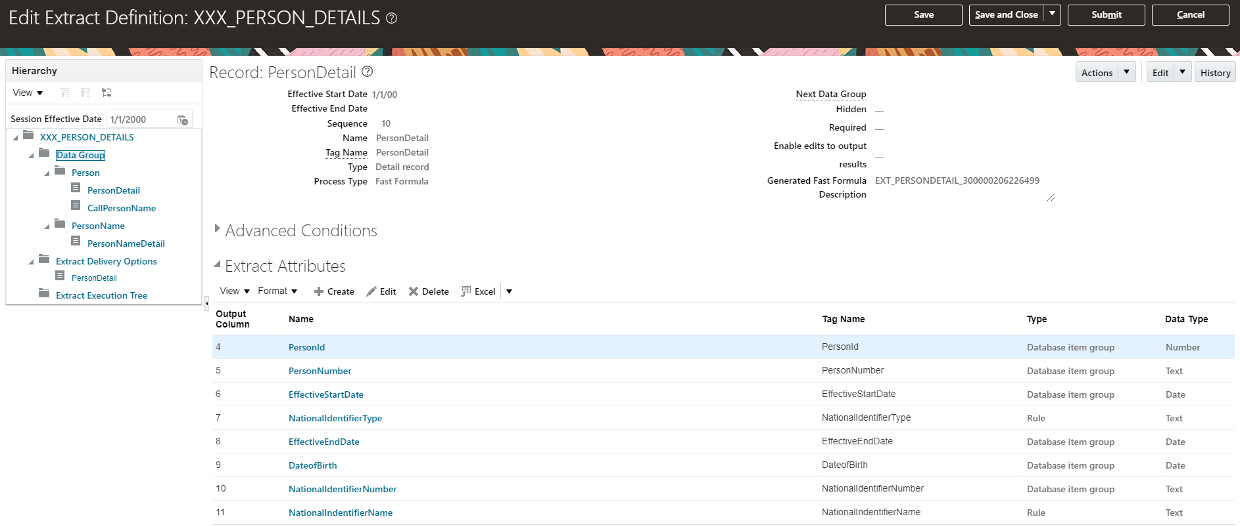
Create Extract Attributes / Data Elements
Notes:
Search for a user entity in the View User Entity Details UI and click the User Entity Details tab.
In the View User Entity Details UI, search for a user entity and click the Context tab. The Contexts Required section lists the contexts that you have to set to use the user entity in the extract. For example, the PER_PER_PHONES_UE user entity requires the PERSON_ID context; therefore, you must set the PERSON_ID context to use this user entity. Generally, the user entities that are not historic require the EFFECTIVE_DATE context. However, the EFFECTIVE_DATE context is set by default, so you do not have to set this context explicitly.
Search for UE with table name with the SQL below:
select * from FF_ROUTES where route_id =(select route_id from ff_user_entities_vl where base_user_entity_name = 'HWM_PER_ASG_USER_PERSON_TYPE')

Slide 18
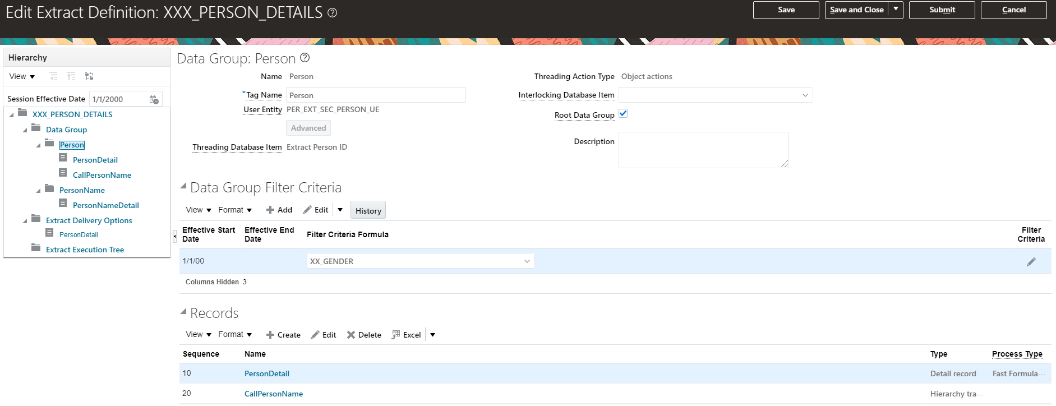
Data filter Criteria
The Group filter criteria can be used to filter the data as needed. The Parameters of the extract are also available to be used here.

Slide 19
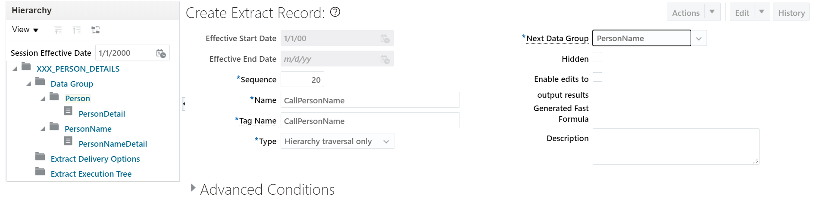
Create Traversal Record to Navigate Block to Block
A Traversal record is used to move from one UE to another.

Slide 20
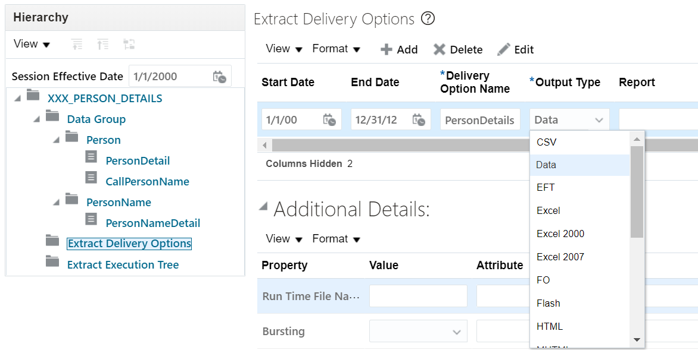
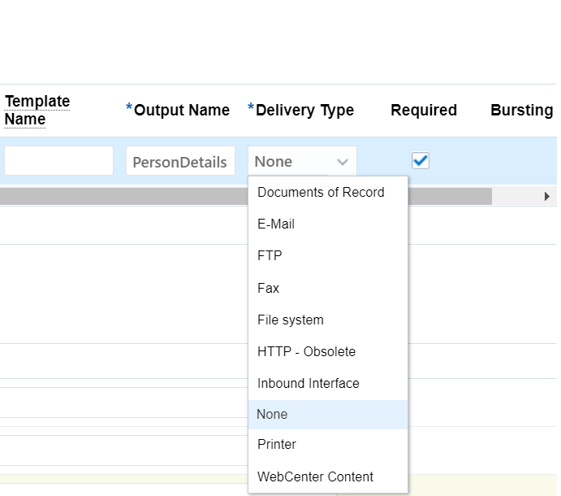
HCM Extract Delivery Options
Delivery Options are the output type setting.

Slide 21
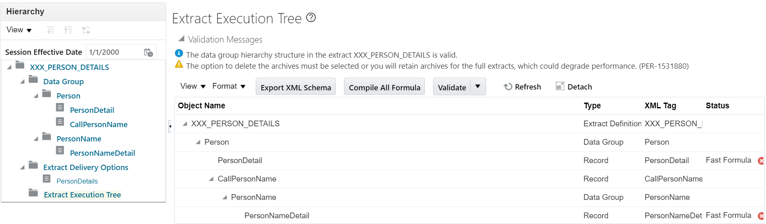
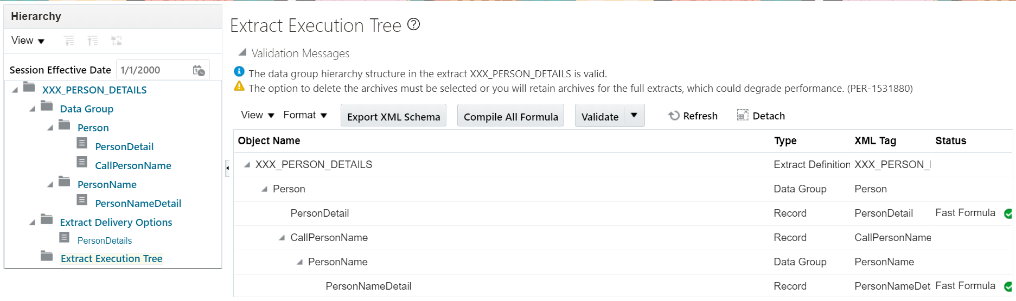
Extract Definition validation
Extracts must be validated to execute them.

Slide 22
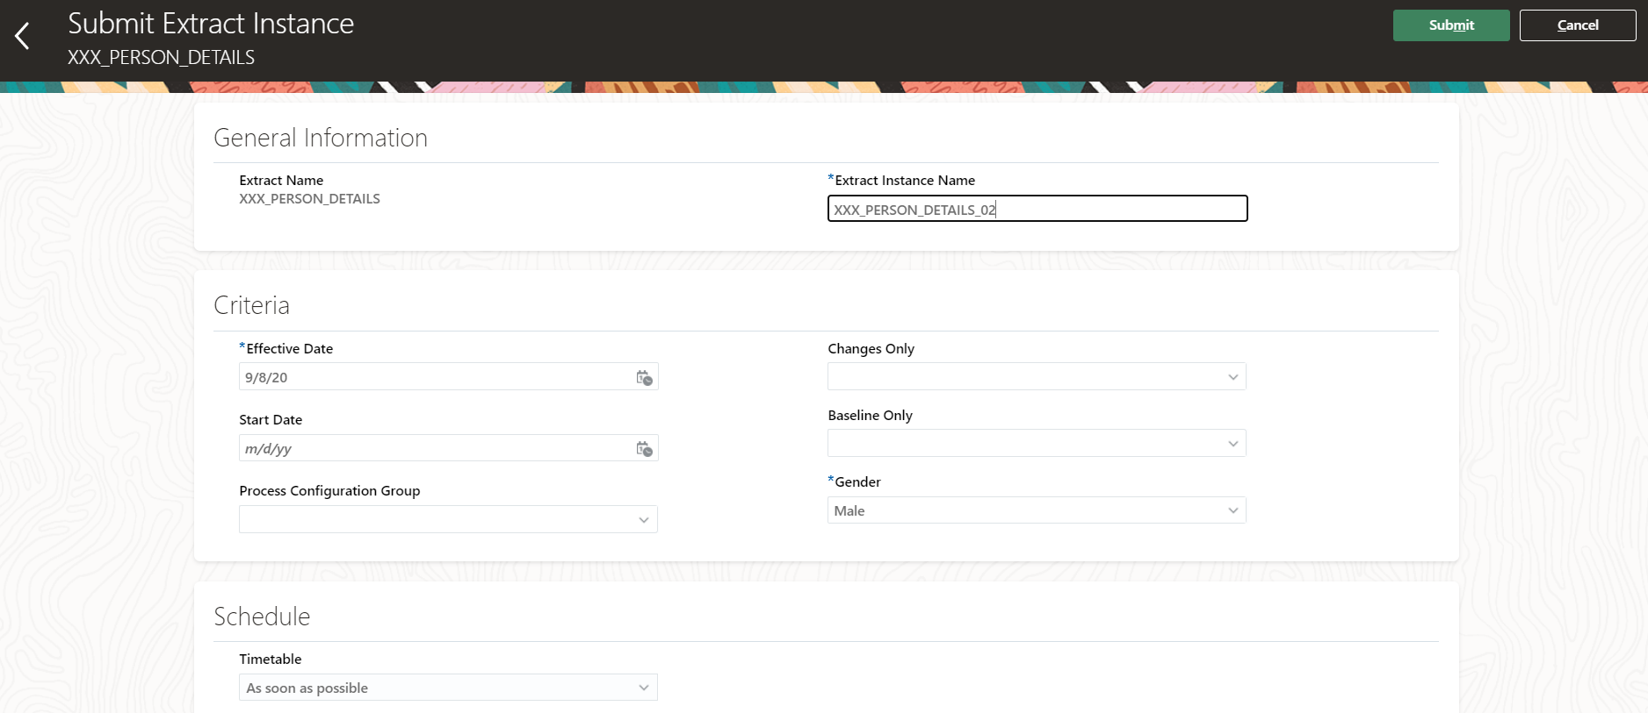
Submit HCM Extract
Select Submit extract to execute an extract. Enter a unique extract instance name, the mandatory parameters and enter the date you want the process to run as on in effective date

Slide 23
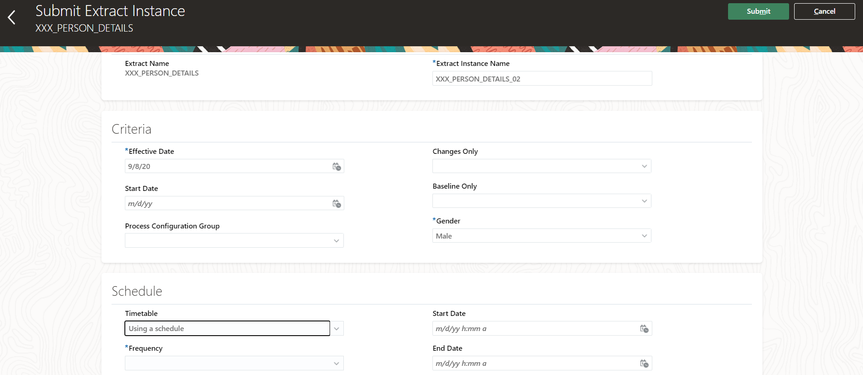
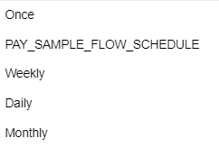
Schedule HCM Extract
Choose ‘As Soon as possible’ if you want to immediately run the process, or select ‘Use a schedule’ if it is a recurring process, and Select the Frequency, Start date and time and End date and time. Click on Next and Submit.

Slide 24
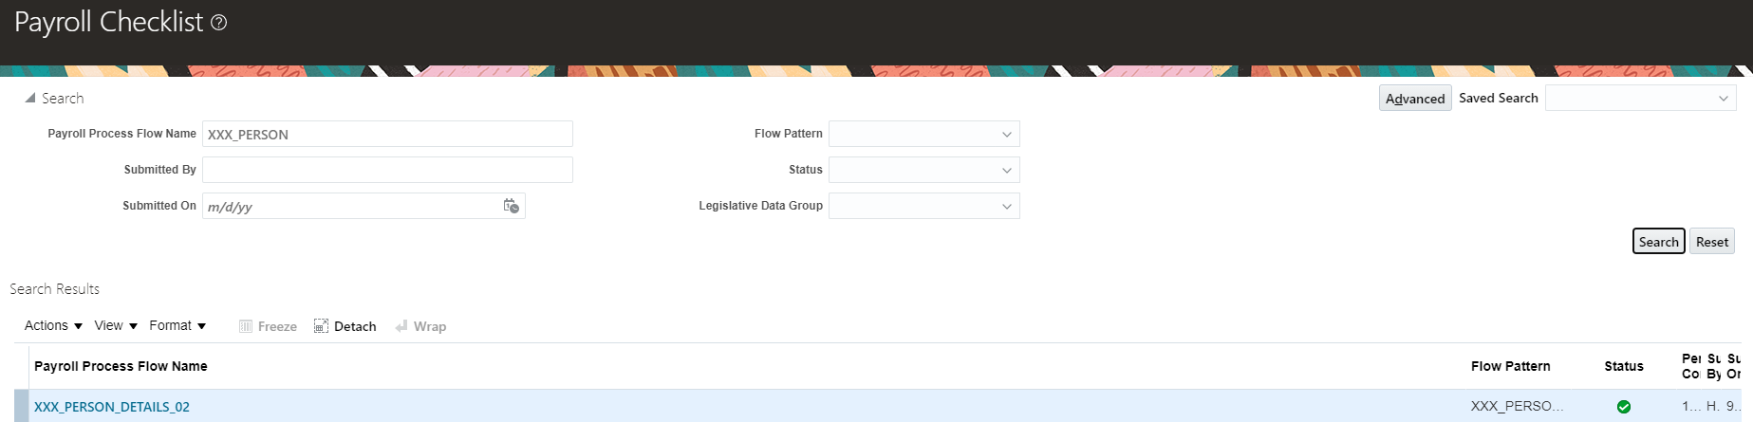
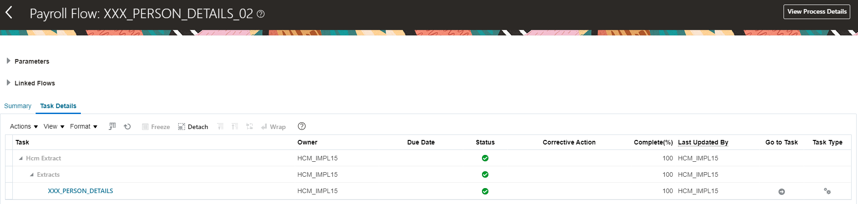
Extract Status
Navigator> Payroll> Checklist

Slide 25
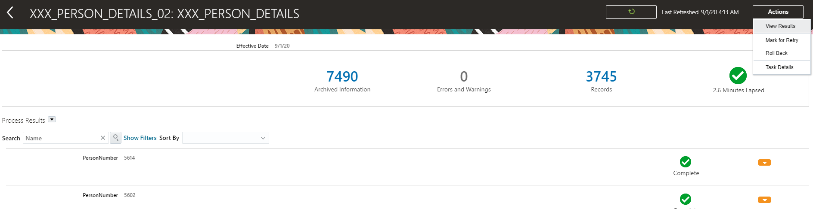
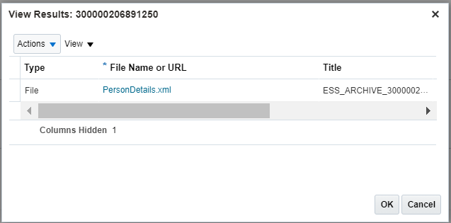
Extract Status

Slide 26
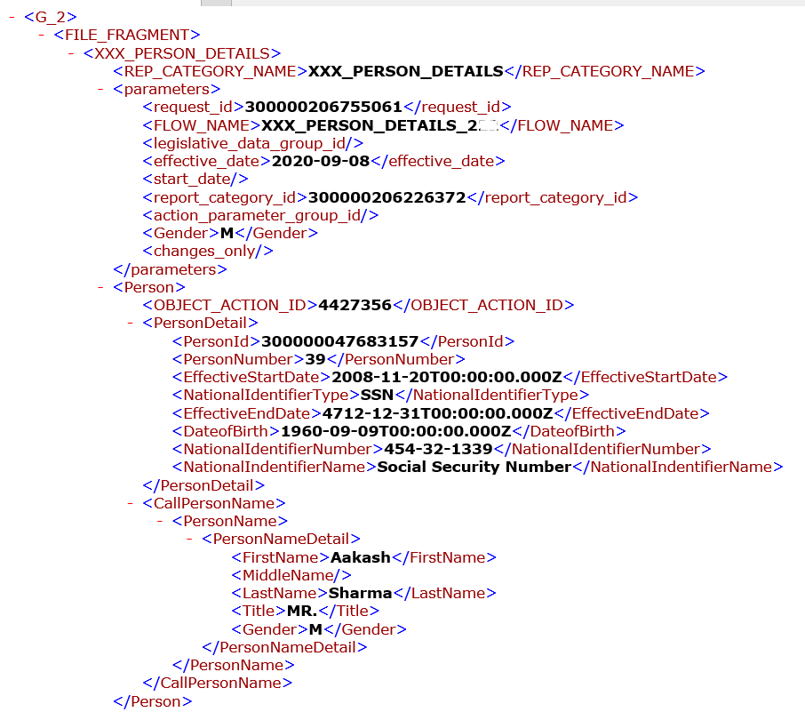
Extract Output XML

Slide 27
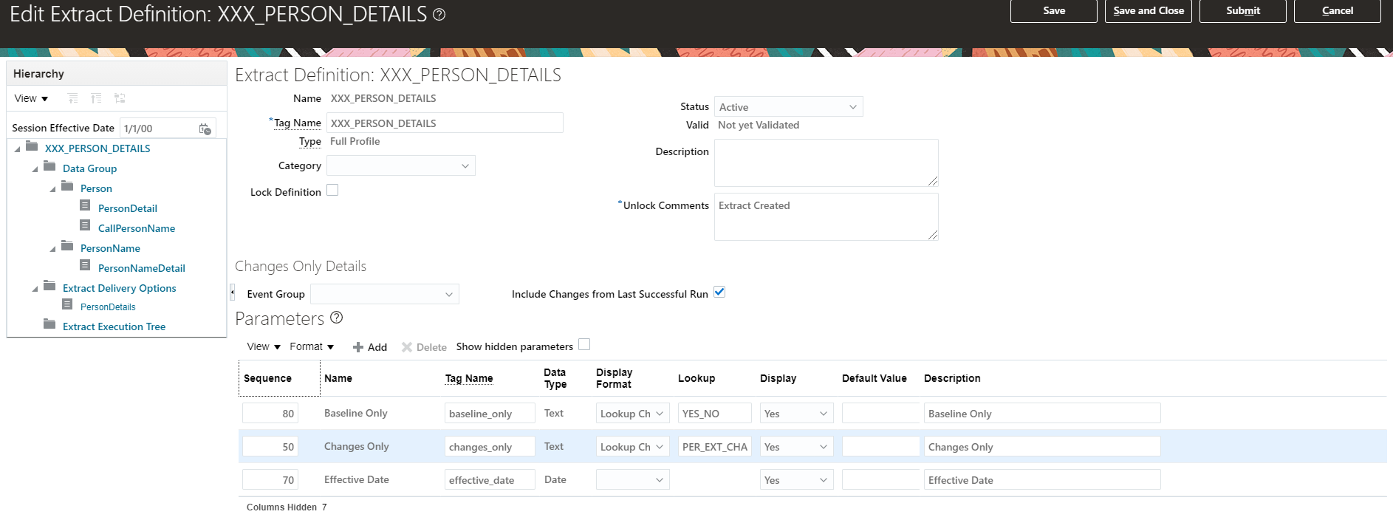
Incremental Extract - How to set-up Changes Only data extract
Navigate to the Extract Definition select "Changes Only" parameter and select Display as “Yes”

Slide 28
Changes Only Mode
Mode | Lookup Value | Description
N | All attributes | Includes all data in the extract. A full extract is run which produces the full data output at that point of time. The archived data is utilized as a baseline.
Y | Changed attributes | Compares this extract run with the previous extract runs and by comparing against the baseline (to identify the incremental data), displays the data that has changed only.
ATTRIBUTE | Changed and marked attributes | Includes elements that have changed or marked as mandatory or Always display
ATTRIB_OLD | Changed and marked attributes with previous values | Displays elements that have changed or marked as mandatory or always display plus their previous value Note: You must run the Payroll Interface with the Attrib_Old mode whenever you use the US ADP PayForce Third-Party Periodic Extract.
BLOCK | Changed and marked attributes under threading group | Displays the following data under threading data group: Changed data Data marked as mandatory or always display Parent data group values
BLOCK_OLD | Changed, marked attributes, previous data under threading group | Displays the following data under threading data group: Changed data Data marked as mandatory or always display Parent data group values Previous values
Notes:
Pre-requisties: Include change only parameter
Setup Multithreading Database Item
One key attribute must be selected for the record. Based on this key attribute and database item, system will check whom changes have been applied and what is the reference id.

Slide 29
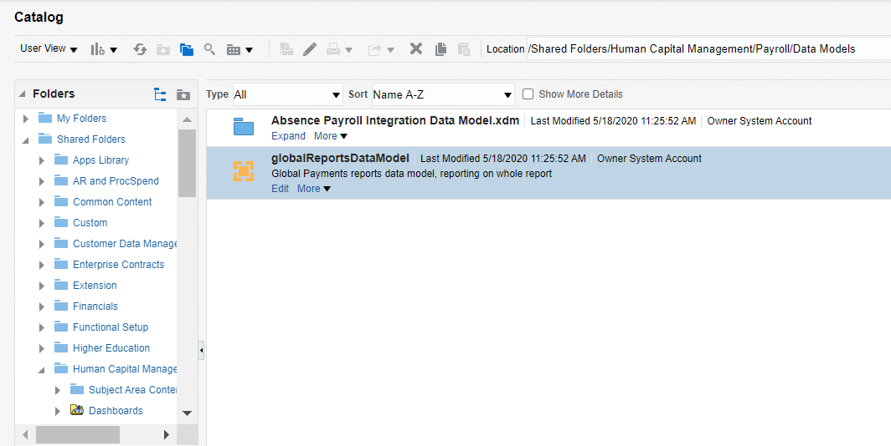
HCM Extract - BI Report
Navigate to Report & Analytics >Catalog > Shared Folders > Human Capital Management > Payroll > Data Models
Copy the “globalReportsDataModel “ and paste in Custom folder

Slide 30
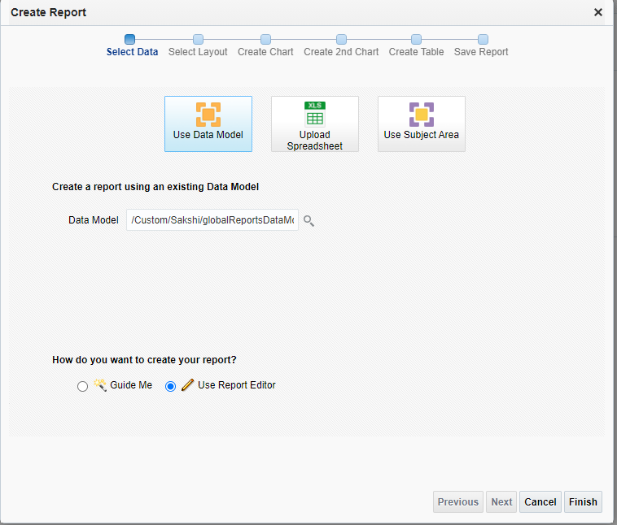
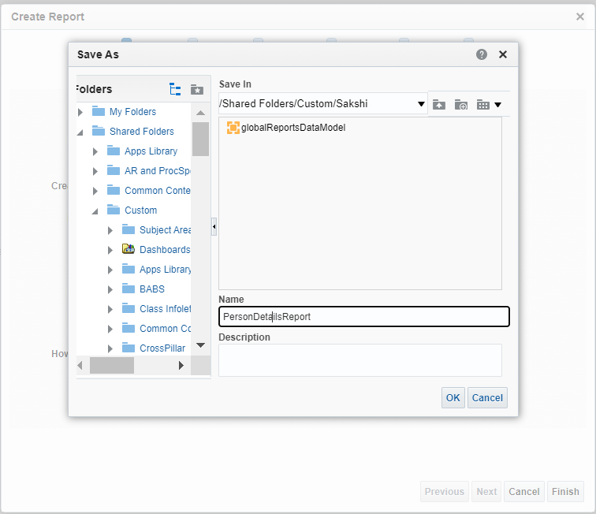
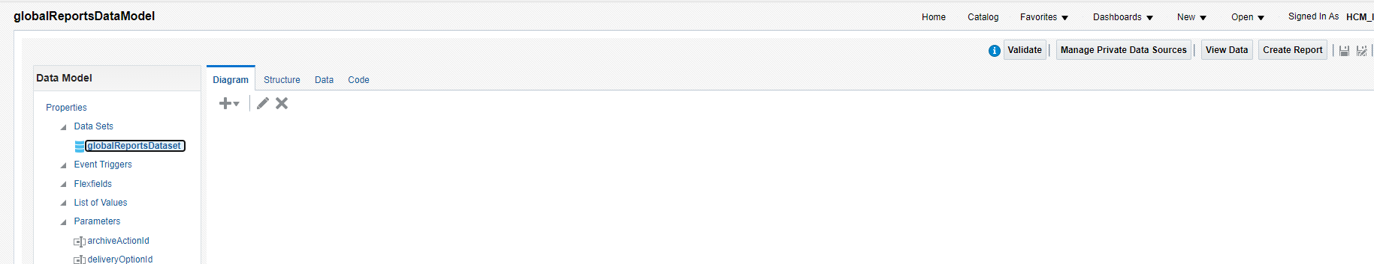
HCM Extract - BI Report
Click on Edit and Create Report
Select - Use Report Editor and click on Finish and save the report.

Slide 31
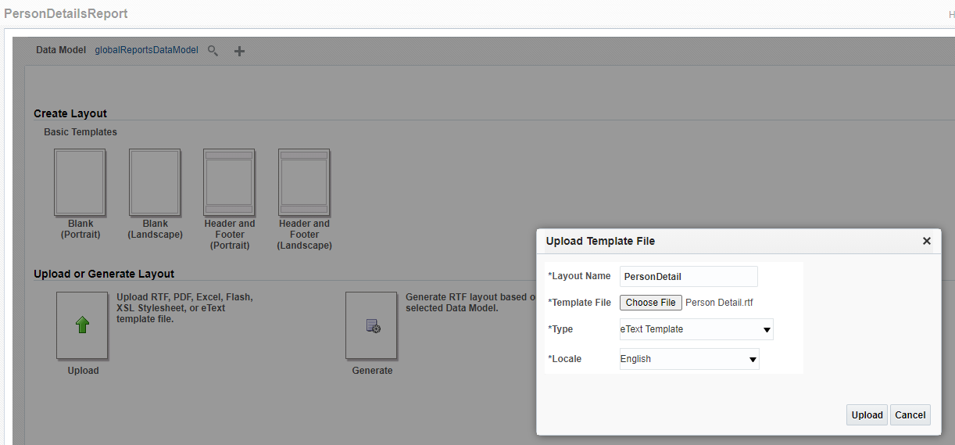
HCM Extract - BI Report
Upload the rtf template

Slide 32
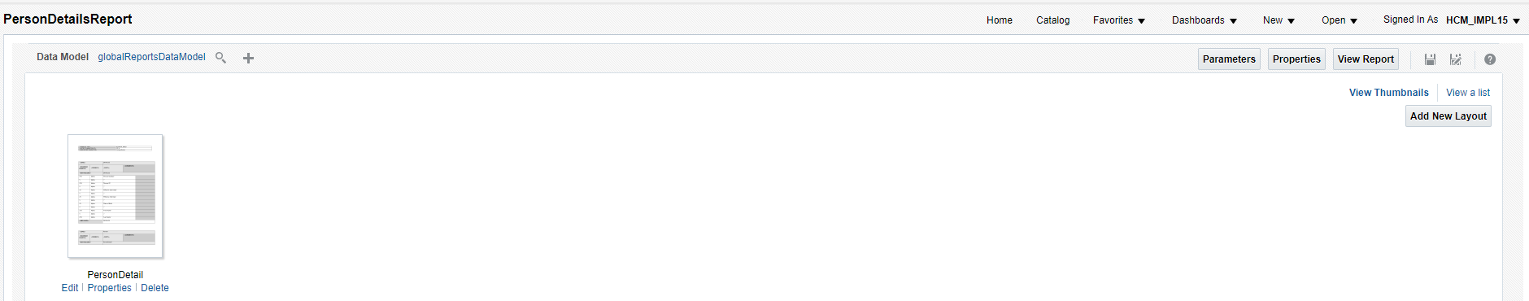
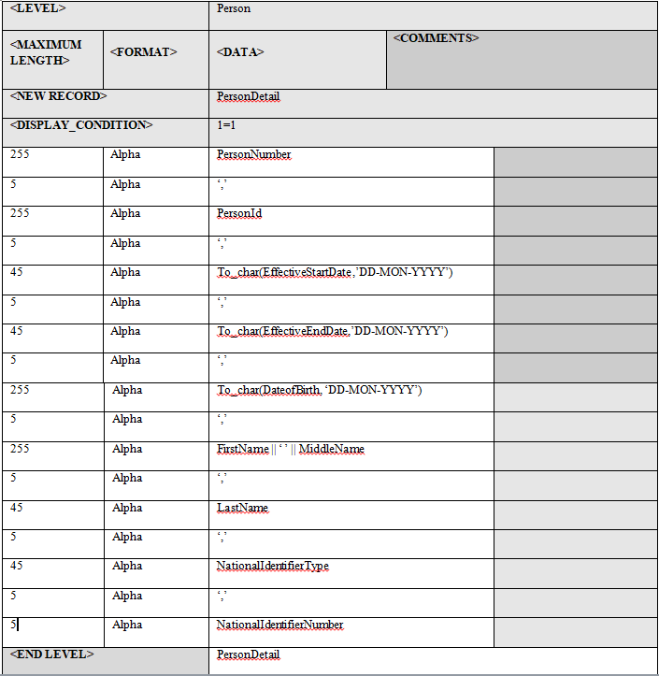
HCM Extract – BI Report
E-text template:

Slide 33
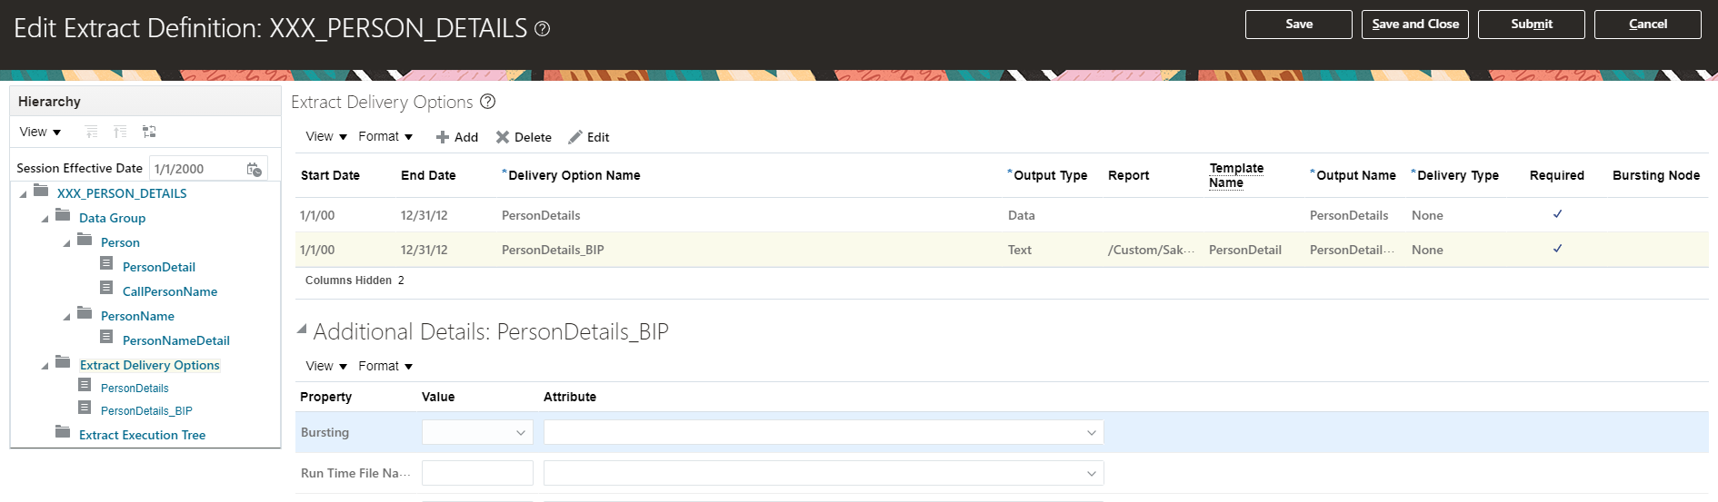
HCM Extract – BI Report – Delivery Options

Slide 34
HCM Extract – Fast Formula
You can use fast formula at the following levels:
Extract Criteria level to determine certain conditions used at the data group filter level.
Extract Rule level to derive/calculate attribute values.
Extract Advanced Condition level to specify complex conditions and is used in the Record/data element advanced condition list.
Extract Record level to automatically generate formulas when you use the Generate Formula option.

Slide 35
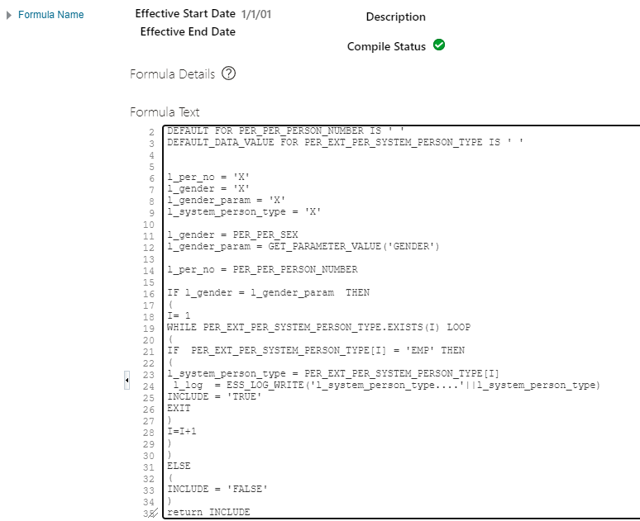
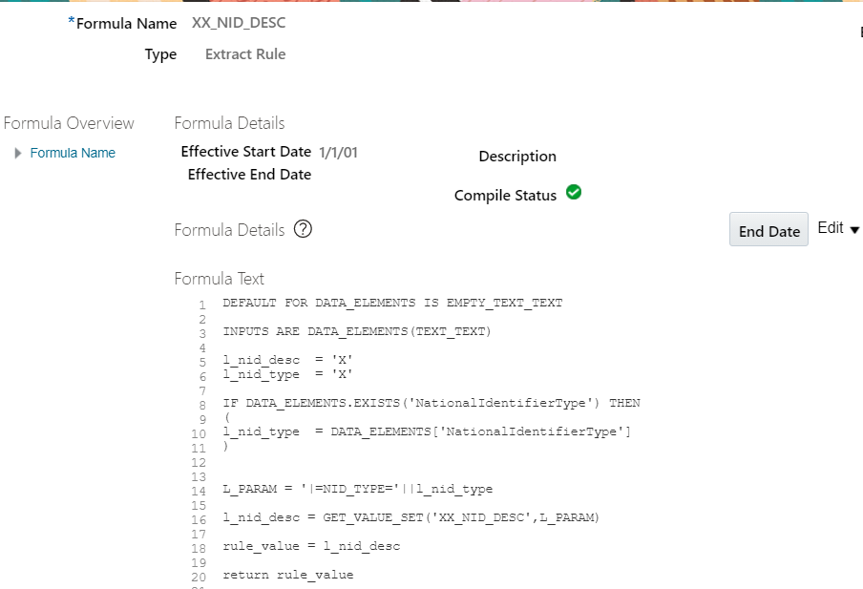
HCM Extract – Fast Formula
Extract Criteria Extract Rule

Slide 36
Thank you

